Slide 1
Intro to the {tidyverse}: Essential R Packages
Pat Callahan
UCSF Memory and Aging Center
8/11/2020
Notes:
Welcome, and thanks for coming to pres. on the tidyverse packages
Assumptions: you have at least a beginner knowledge of R; that is, you’ve opened R and maybe even used it as a fancy calculator
Base R can get data cleaning and preparation jobs done, yes, but man was it a slow, unfriendly, and frankly unrewarding process to learn how to do these processes, and then actually accomplish them
Hopefully some of what I teach today will help others avoid wasting time learning unnecessary Base R approaches.
Programming and code should only serve to expedite processes and alleviate our workloads

Slide 2
Learning Goals
Overview of the Tidyverse and its packages
Benefits of the Tidyverse
Tutorial demonstrating a Tidyverse workflow
Notes:
Will review Tidyverse goals, philosophy, and the major packages in it
Explain how those packages can be beneficial to you
Present a tutorial of some of the core packages and functions from the Tidyverse
Moreover, I want the tutorial to serve as a quick-start guide for some of the most essential data cleaning tasks

Slide 3
What is the Tidyverse?
Collection of data reading, writing, cleaning, manipulation, and workflow packages designed for data science
Designed to be cohesive and interfunctional
Authored and maintained by RStudio
Jim Hester, Yihui Xie, Jenny Bryan, Hadley Wickham, many more
Notes:
At its core: packages for data science and preparation; not so much meant for analysis, but allowing you to prep data for analysis
Packages designed with one another in mind
Authored by RStudio totally free as the use of these packages make R more appealing and thus improve their business.
Quick note on RStudio: most popular IDE for R. An IDE is a one-stop shop for interactively writing, running, and editing code
Sometimes referred to as Wickahmverse
Ok so we know that the tidyverse is a bunch of data science packages—what strings them all together?
Phonetic: ye-we shea

Slide 4
Tidyverse Philosophy
Shared grammar across packages
Learn 1 package, learn them all*
Functional programming oriented with easy workflows
Pipe operator, multi-function construction, etc.
Code should be human readable, machine executable
Function naming scheme: verb_*()
Ex: read_csv() and filter_at()
Notes:
Shared API asterisk(*): ggplot2 was developed very early so it struggles to adhere to some of the rules, but everything else is A+ in sharing structure
Improved workflow through the pipe operator
Human readable, machine executable is a simple but elegant concept emphasizing the need for humans to simply read the code and understand it
Realized through clear, consistent function naming scheme:
Verb_*() is general structure, often verb_adjective() or verb_noun()
Example of this is filter_at(). Even if you don’t know anything about R, you can presume that something is going to be filtered on a certain condition and ”location” so-to-speak

Slide 5
5 Reasons to use {tidyverse}
Execution Speed
Many functions outsourced to C++ for efficiency
Default documentation
Opinion: package vignettes and function help is great
Functional and convenient
Pre-existing functions for most data cleaning procedures
“Because everyone else uses them”
Existing explanations at Stack O and RStudio Community
Readability of your code
Easier to write, share, reproduce, and understand later
Notes:
Going to tell you reasons why you should use these packages now, and I’ll make the case for them later or ask you to take my word for it.
Take my word: 1, 2, 3
Google it: 4
Will show: 5
General overview of tidyverse complete, now what are the packages that comprise it?

Slide 6
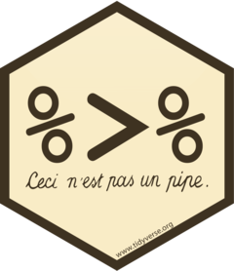


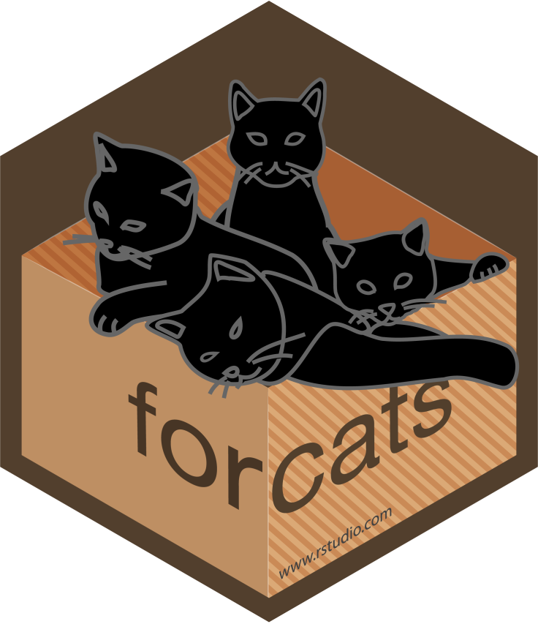
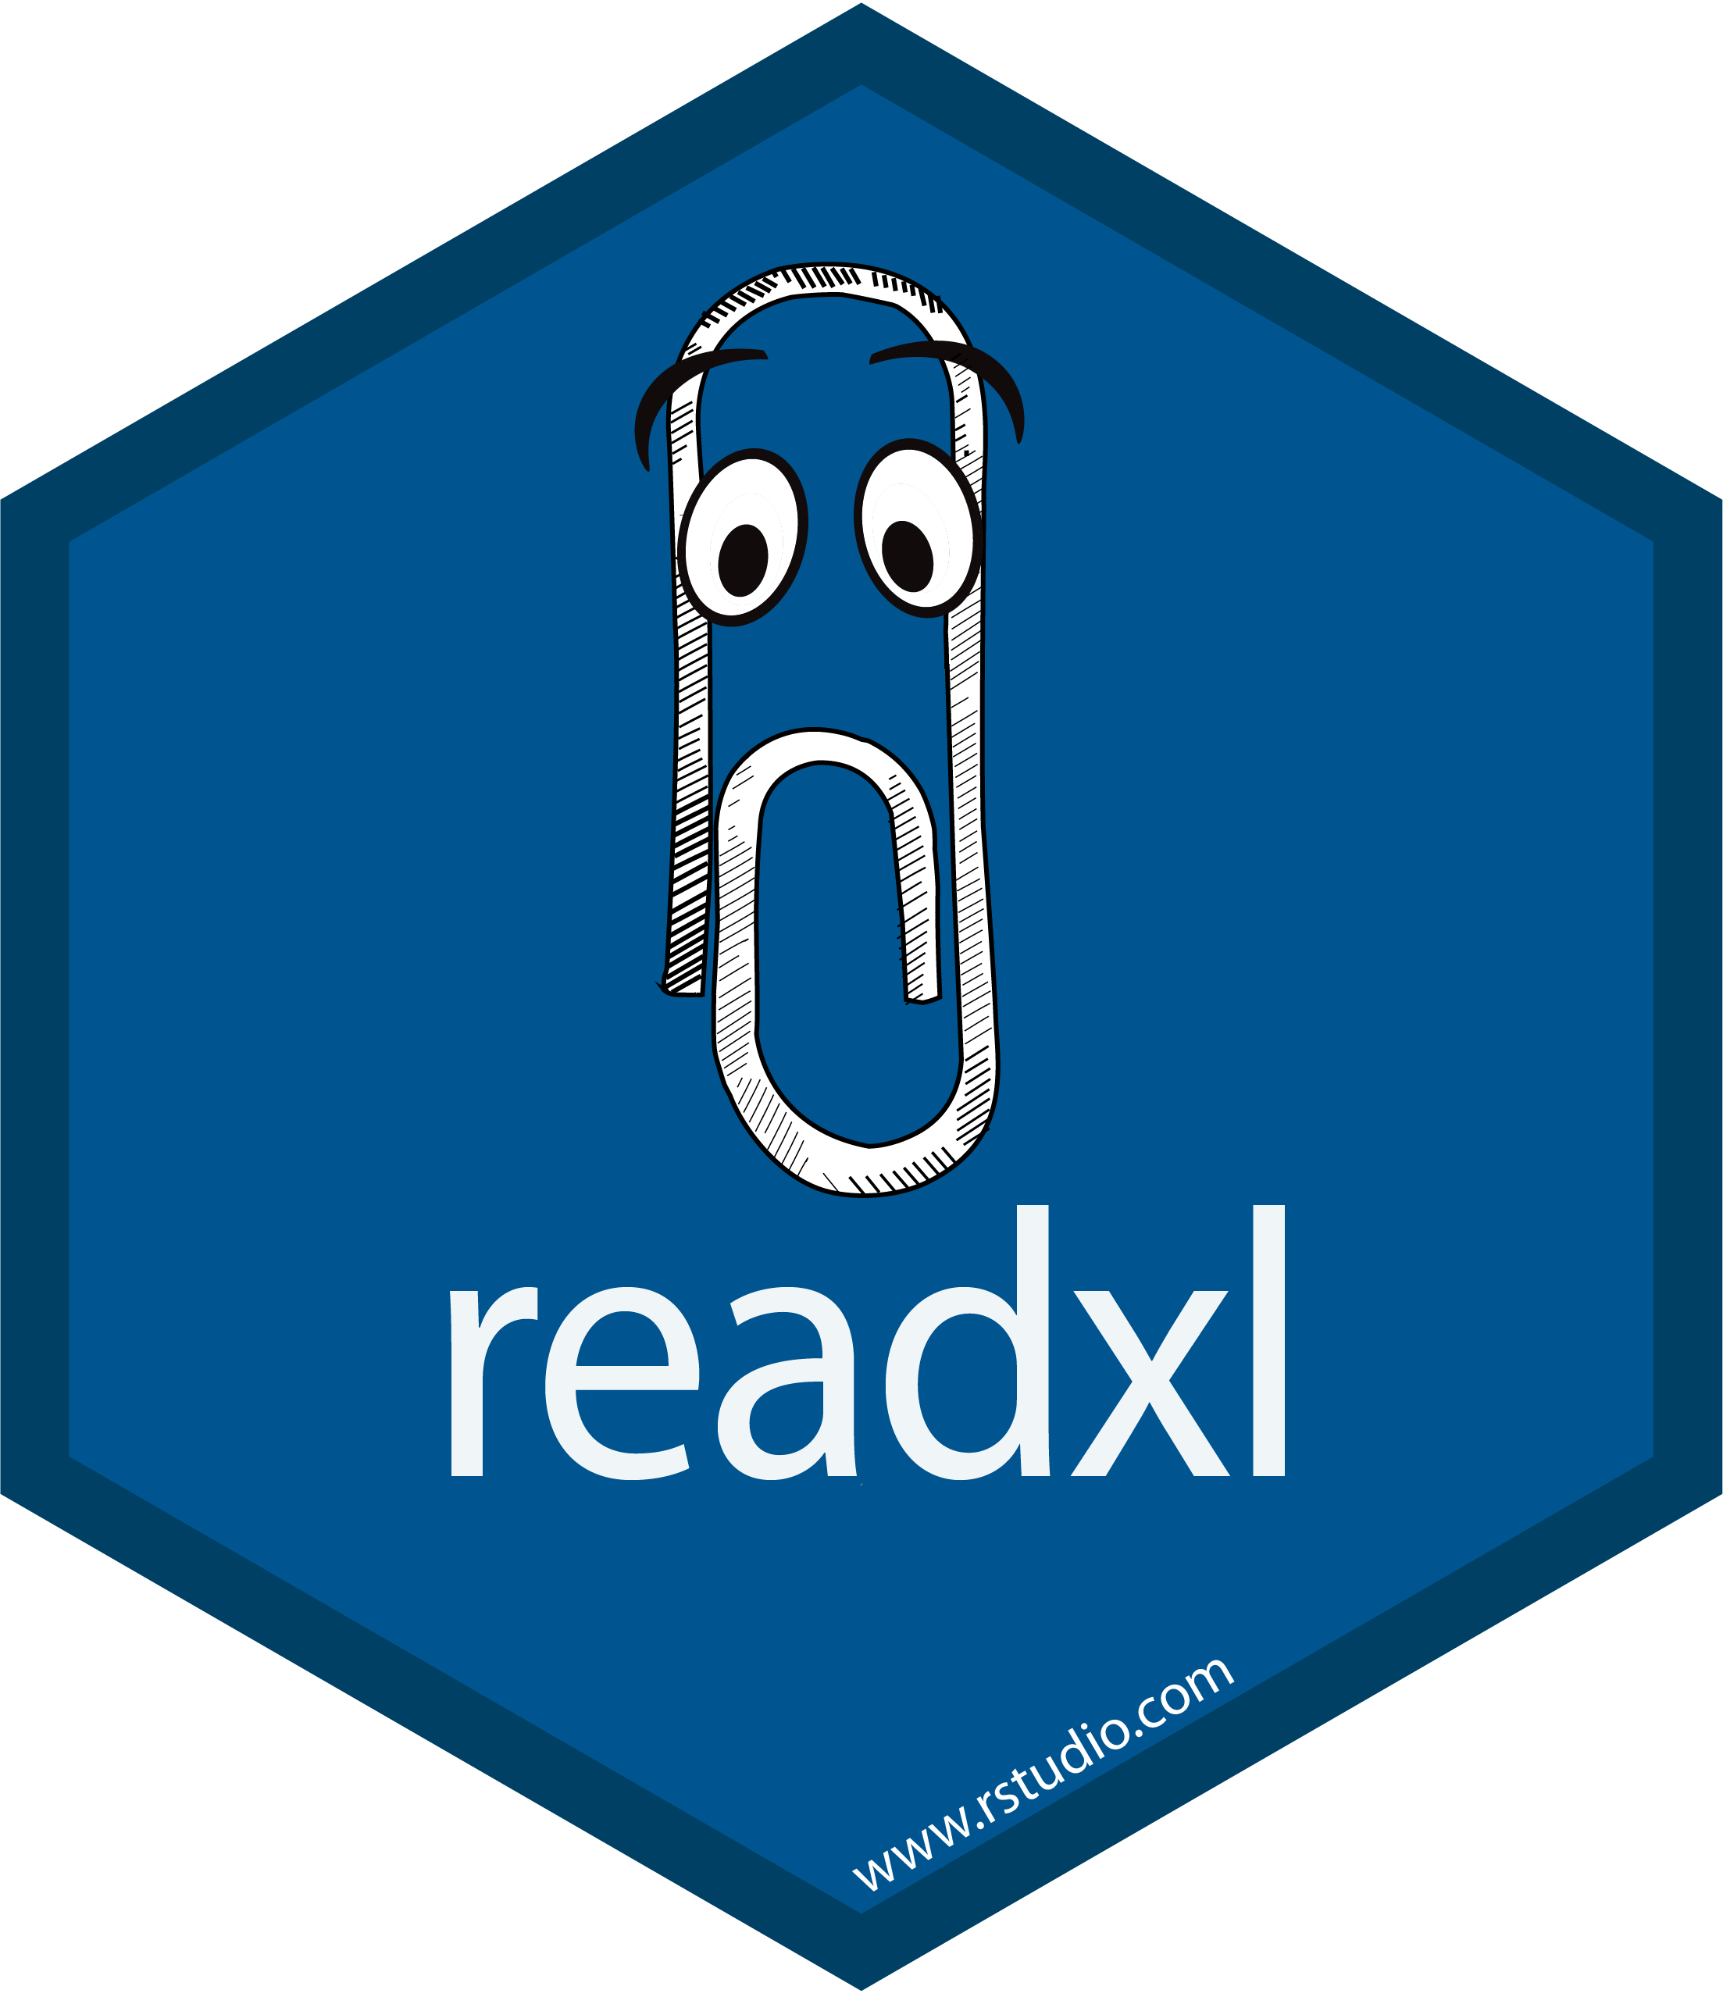
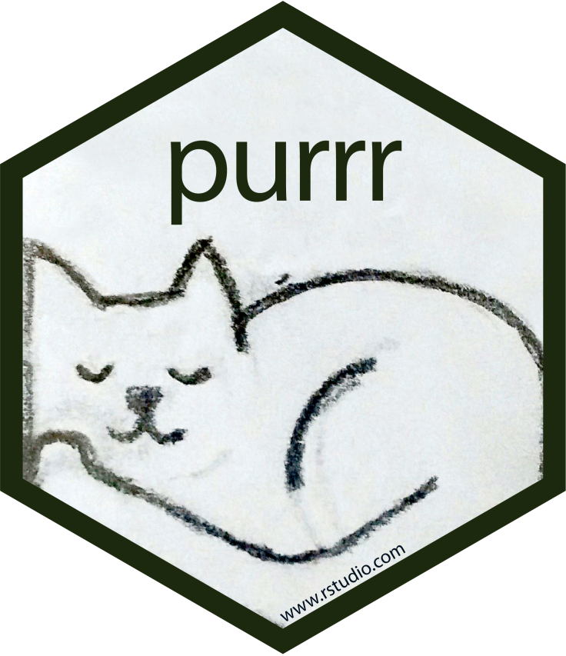
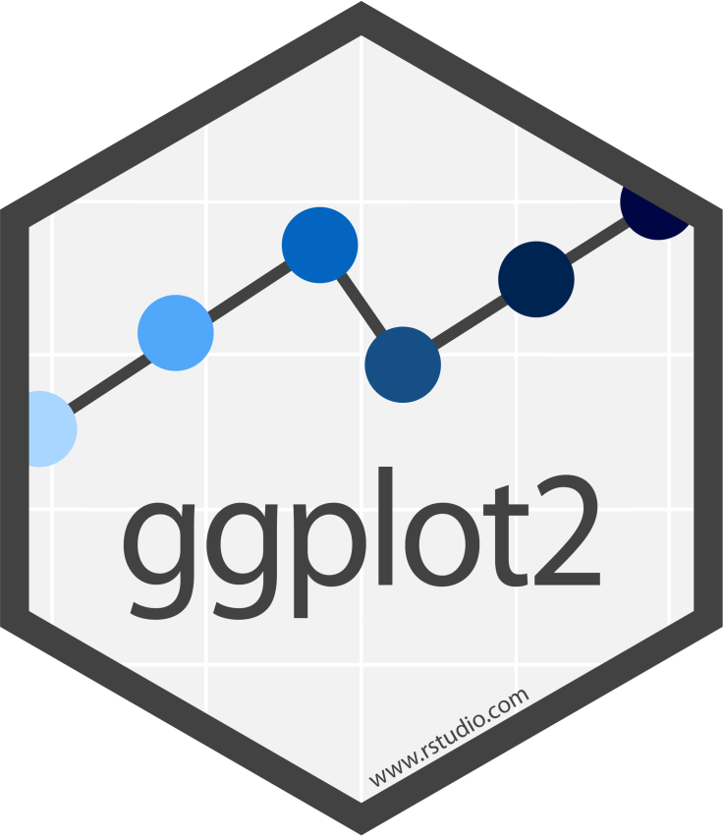
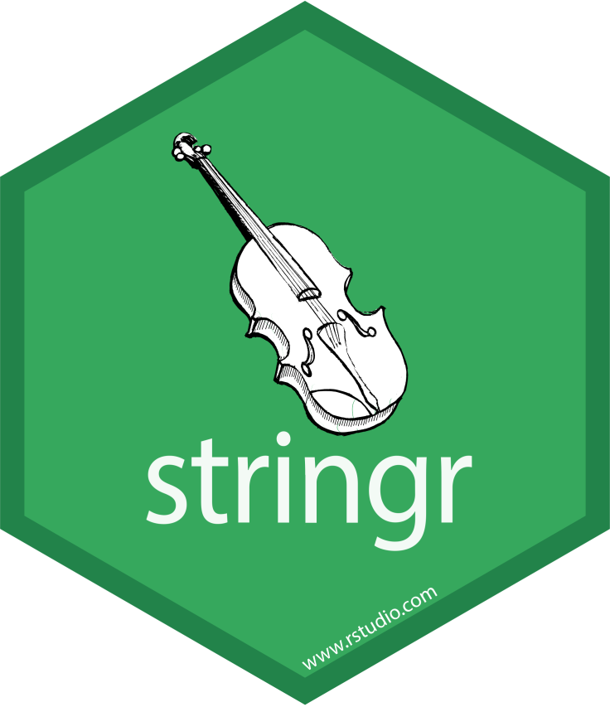
{tidyverse}
Notes:
Additional packages: lubridate, tibble, readr, more
Going to review some of the major packages and when you should look to them. Simply too much to cover on each of them

Slide 7
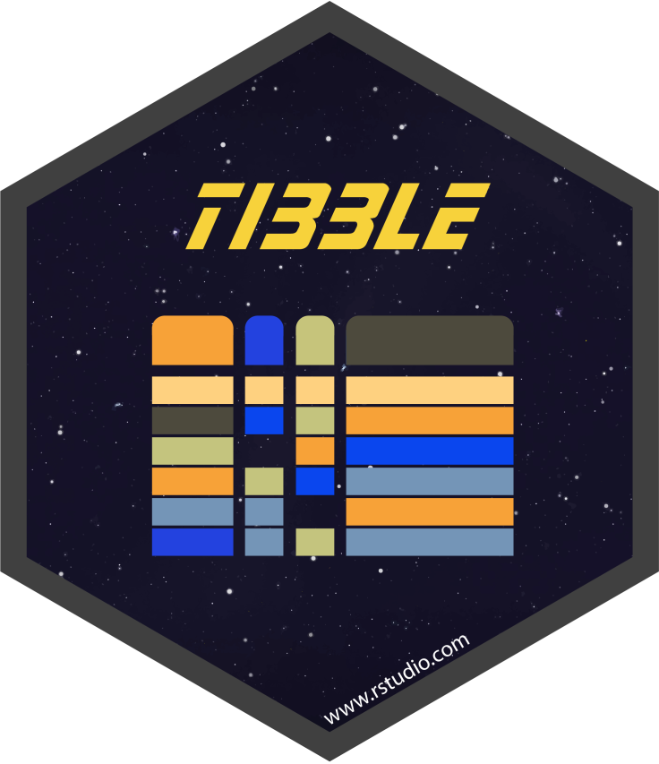

Reading and Writing Data
Read and write *.xlsx and *.xls files
Read and write most delimited data formats (*.csv, *.tsv, etc.)
Create tibbles interactively
Notes:
Readxl most applicable to most of you
Readr has generalized approaches for reading in tabular data such as CSVs, TSFs, etc. and other files like .zip or compressed tarballs
Tibbles are a concept that I’ll cover at next week’s presentation, but for all intents and purposes they are another form of data frame or data table and all of the read functions from readxl and readr will turn your data into a tibble (which is a good thing)

Slide 8
Cleaning Data: Fundamentals
Fast, consistent tools for working with data frames
Create tidy datum/data
Notes:
Arbitrarily separated packages that both serve some of the essential goals in any data cleaning process although I certainly use functions from {dplyr} far more commonly than {tidyr}
I think the logos capture some of the idea in how these packages are different
When I want to clean and manipulate my data, I start with sweeping changes to the data frame like adding and deleting columns or changing column-wide values. Then I move to tidyr for deeper cleaning procedures
Not saying this is a precise workflow in any way at all—just a note based on my experiences with cleaning data
These packages really go hand-in-hand

Slide 9
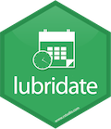
Cleaning Data: Advanced
Process character strings/text
Reorder and modify factor levels
Work with date-times and time-spans
Notes:
Stringr built to easily interface with character vectors; extract, substitute, remove, and otherwise alter strings explicitly or with regular expressions
Functions recognizing Unicode values
Forcats built to interact with factor vectors: largely useful for lumping numerical data into categorical data with super readable code
Lubridate built around the idea that dealing with dates and times should be easy, and does all of the work for you in converting dates to various different formats and calculating over time. Invaluable for any sort of time-series work
Find it easier to work with this than remembering POSIXct or POSIXlt

Slide 10
Other Powerful Packages
Workflows and the forward pipe operator, %>%
Easy, simple, and beautiful plot creation
Iterate functions over lists and data frames
Notes:
Magrittr: this is not a pipe, The Treachery of Images
Magrittr mostly known for the forward pipe which passes results from one step to the next step; to be demonstrated
Ggplot2: most common graphics plotting device in R, most adaptable, and the prettiest
Purrr: introduces various permutations of the map() function so you can iterate functions over elements of lists or data frames.

Slide 11
Essential Packages: Workflow Tutorial
Readxl/readr, dplyr, magrittr, ggplot2
Highlight the 5 main dplyr verbs
Make note of how ggplot2 uses `+` rather than `%>%` as a legacy issue

